Slide 1
NoSql Database
Dr. Salahuddin

Slide 2
NoSQL database
NoSQL database technology stores information in JSON documents instead of columns and rows used by relational databases. To be clear, NoSQL stands for “not only SQL” rather than “no SQL” at all. This means a NoSQL JSON database can store and retrieve data using literally “no SQL.” Or you can combine the flexibility of JSON with the power of SQL for the best of both worlds. Consequently, NoSQL databases are built to be flexible, scalable, and capable of rapidly responding to the data management demands of modern businesses. The following defines the four most-popular types of NoSQL database:

Slide 3
NoSQL databases are generally classified into four main categories:
Document databases are primarily built for storing information as documents, including, but not limited to, JSON documents. These systems can also be used for storing XML documents, for a NoSQL database example.
Key-value stores group associated data in collections with records that are identified with unique keys for easy retrieval. Key-value stores have just enough structure to mirror the value of relational databases (as opposed to non-relational databases) while still preserving the benefits of the NoSQL database structure.

Slide 4
NoSQL databases are generally classified into four main categories:
Wide-column databases use the tabular format of relational databases yet allow a wide variance in how data is named and formatted in each row, even in the same table. Like key-value stores, wide-column databases have some basic NoSQL structure while also preserving a lot of flexibility
Graph databases use graph structures to define the relationships between stored data points. Graph databases are useful for identifying patterns in unstructured and semi-structured information.

Slide 5
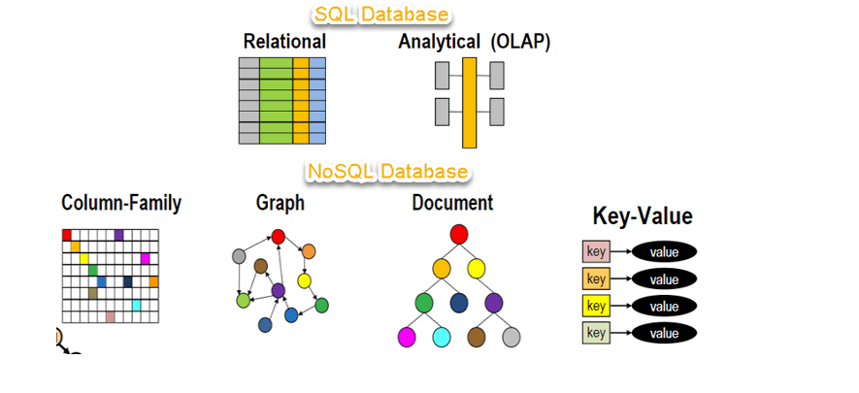

Slide 6
Why use NoSQL?
Customer experience has quickly become the most important competitive differentiator and ushered the business world into an era of monumental change. As part of this revolution, enterprises are interacting digitally – not only with their customers, but also with their employees, partners, vendors, and even their products – at an unprecedented scale. This interaction is powered by the internet and other 21st century technologies – and at the heart of the revolution of NoSQL are a company’s big data, cloud, mobile, social media, and IoT applications.

Slide 7
Why use NoSQL?
Support large numbers of concurrent users (tens of thousands, perhaps millions)
Deliver highly responsive experiences to a globally distributed base of users
Be always available – no downtime
Handle semi- and unstructured data
Rapidly adapt to changing requirements with frequent updates and new features

Slide 8
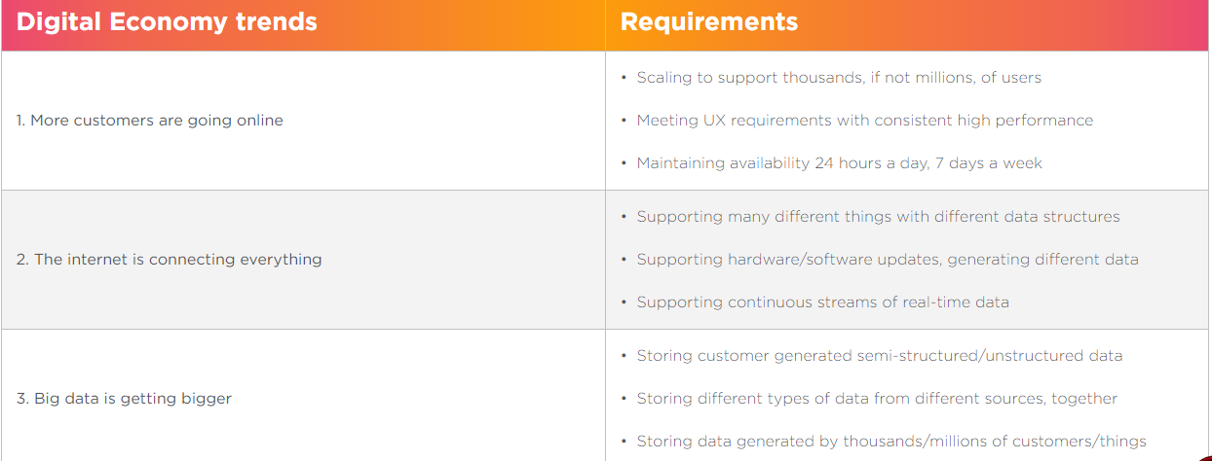
Five trends creating new technical challenges that NoSQL DBs address

Slide 9
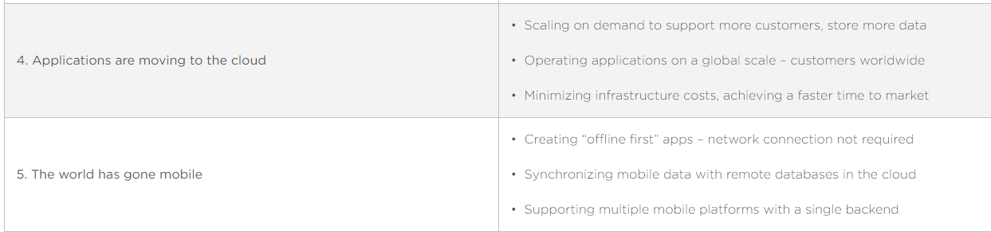
Five trends creating new technical challenges that NoSQL DBs address

Slide 10
Develop with agility
To remain competitive in today’s experience-focused digital economy, enterprises must innovate – and they have to do it faster than ever before. And because this innovation centers on the development of modern web, mobile, and IoT applications, developers have to deliver applications and services faster than ever before. Speed and agility are both critical because these applications evolve far more rapidly than legacy applications like ERP (Enterprise Resource Planning (ERP) . Relational databases are a major roadblock because they don’t support agile development very well due to their fixed data model.

Slide 11
Scoping for changing requirements
A core principle of agile development is adapting to evolving application requirements: when the requirements change, the data model also changes. This is a problem for relational databases because the data model is fixed and defined by a static schema. So in order to change the data model, developers have to modify the schema, or worse, request a “schema change” from the database administrators. This slows down or stops development, not only because it’s a manual, time-consuming process, but also because it impacts other applications and services.

Slide 12
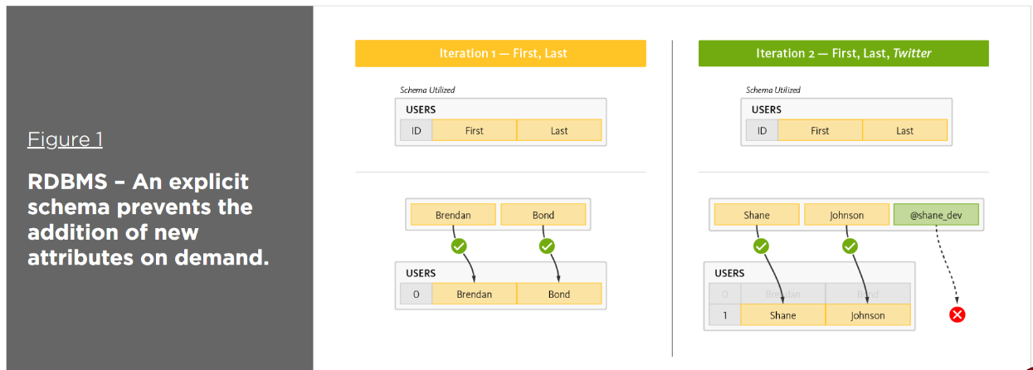

Slide 13
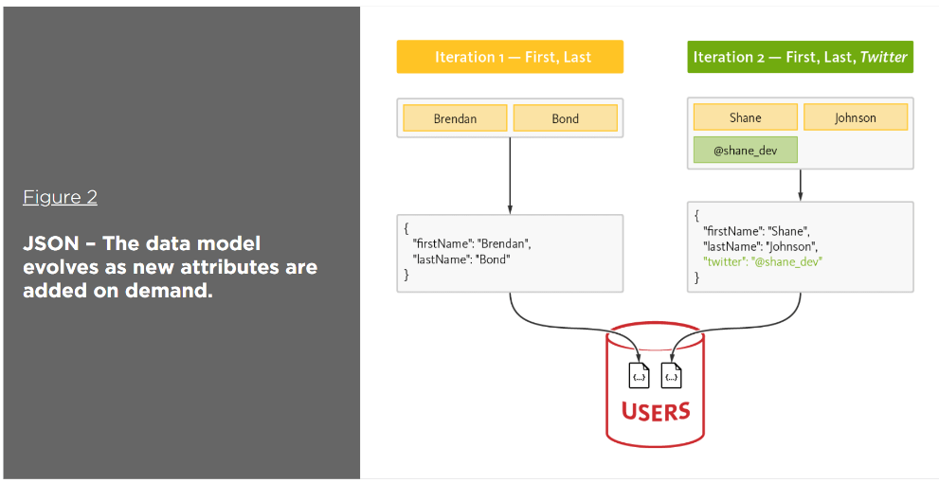
By contrast, a NoSQL database fully supports agile development and does not statically define how the data must be modeled. Instead, NoSQL defers to the applications and services, and thus to the developers as to how data should be modeled. With NoSQL, the data model is defined by the application model. Applications and services model data as objects.

Slide 14
How does NoSQL work?
How does NoSQL compare? Let’s take a closer look. The following NoSQL tutorial illustrates an application used for managing resumes. It interacts with resumes as an object (i.e., the user object), contains an array for skills, and has a collection for positions. Alternatively, writing a resume to a relational database requires the application to “shred” the user object.
Storing this resume would require the application to insert six rows into three tables, as illustrated in Figure 3.
And, reading this profile would require the application to read six rows from three tables, as illustrated in Figure 4.

Slide 15
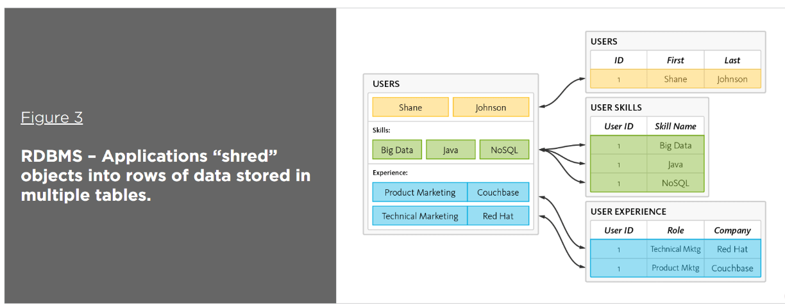
How does NoSQL work?

Slide 16
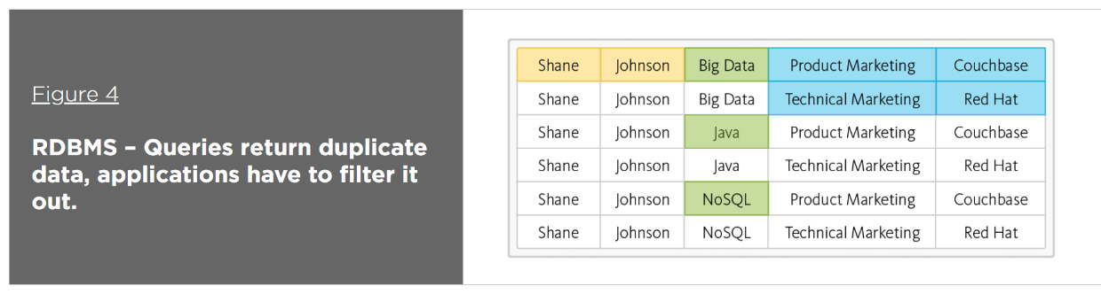
How does NoSQL work?

Slide 17
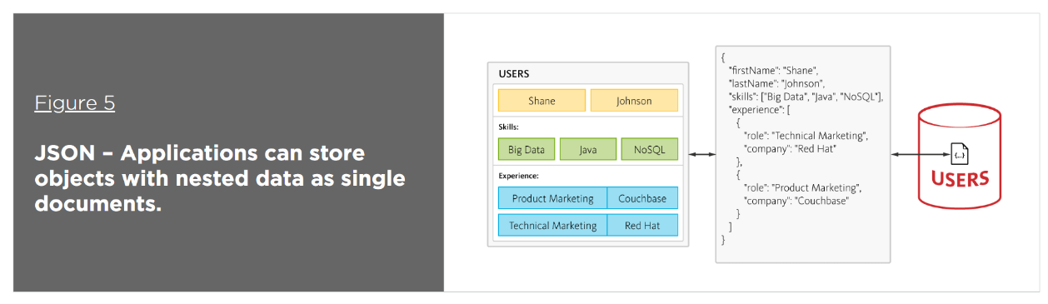
By contrast, in a document-oriented database defined as NoSQL, JSON is the de facto format for storing data – helpfully, it’s also the de facto standard for consuming and producing data for web, mobile, and IoT applications. JSON not only eliminates the object-relational impedance mismatch, it also eliminates the overhead of ORM frameworks and simplifies application development because objects are read and written without “shredding” them (i.e., a single object can be read or written as a single document), as illustrated in Figure 5.

Slide 18
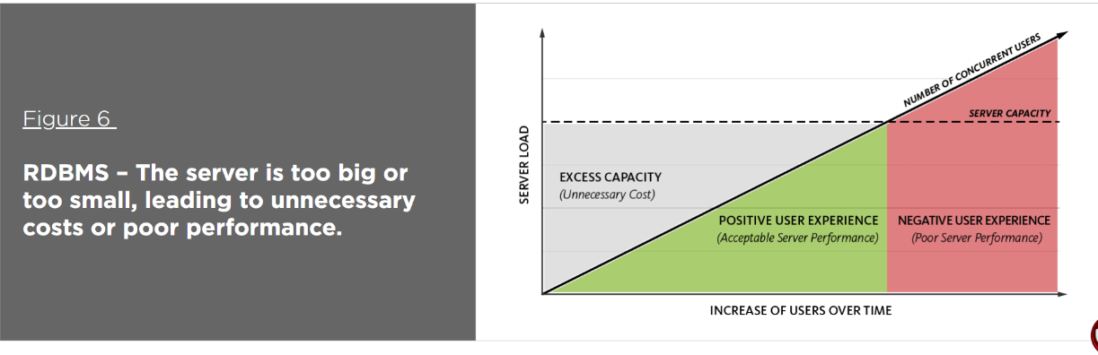
Elasticity for performance at scale

Slide 19
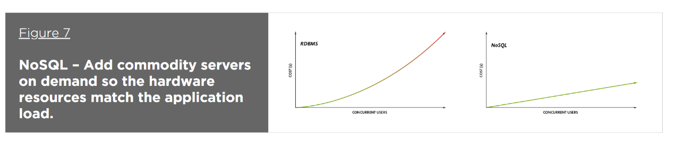
A distributed nosql database, however, leverages commodity hardware to scale out – i.E., Add more resources simply by adding more servers. The ability to scale out enables enterprises to scale more efficiently by (a) deploying no more hardware than is required to meet the current load; (b) leveraging less expensive hardware and/or cloud infrastructure; and (c) scaling on demand and without downtime.

Slide 20
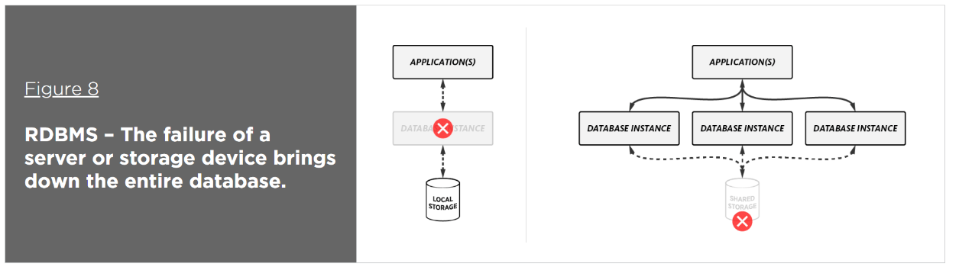
Availability for always-on, global deployment
As more and more customer engagements take place online via web and mobile apps, availability becomes a major, if not primary, concern. These mission-critical applications have to be available 24 hours a day, 7 days a week – no exceptions. Delivering 24×7 availability is a challenge for relational databases that are deployed to a single physical server or that rely on clustering with shared storage. If deployed as a single server and it fails, or as a cluster and the shared storage fails, the database becomes unavailable.

Slide 21
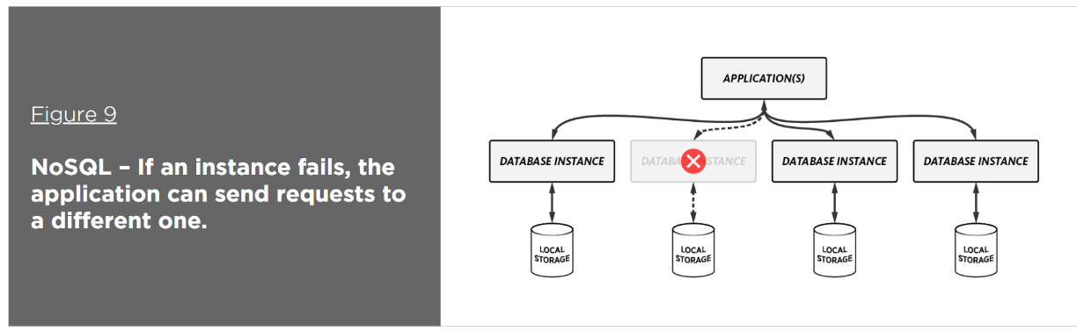
In contrast to relational technology, a distributed, NoSQL database partitions and distributes data to multiple database instances with no shared resources. In addition, the data can be replicated to one or more instances for high availability (intercluster replication). While relational databases like Oracle require separate software for replication (e.g., Oracle Active Data Guard), NoSQL databases do not – it’s built in and it’s automatic. In addition, automatic failover ensures that if a node fails, the database can continue to perform reads and writes by sending the requests to a different node.

Slide 22
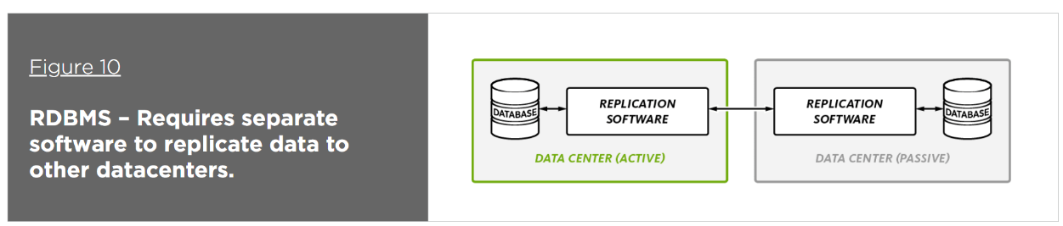
As customer engagements move online, the need to be available in multiple countries and/or regions becomes critical. While deploying a database to multiple datacenters increases availability and helps with disaster recovery, it also has the benefit of increasing performance, because all reads and writes can be executed on the nearest datacenter, thereby reducing latency.
Ensuring global availability is difficult for relational databases in cases where the requirement of separate add-ons increases complexity (e.g., Oracle requires Oracle GoldenGate to move data between databases) – or when replication between multiple datacenters can only be used for failover because only one datacenter is active at a time. Also, when replicating between datacenters, applications built on relational databases can experience performance degradation or find that the datacenters are severely out of sync.

Slide 23
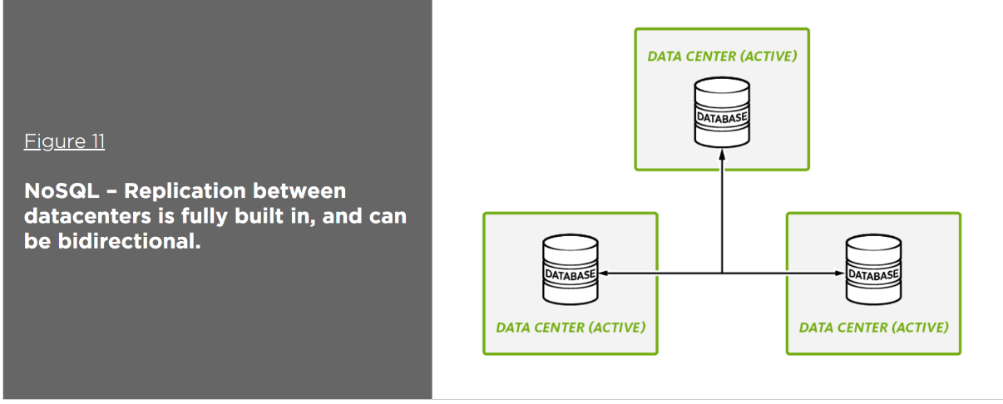
A distributed, NoSQL database includes built-in replication between datacenters – no separate software is required. In addition, some include both unidirectional and bidirectional replication enabling full active-active deployments to multiple datacenters, which allow the database to be deployed in multiple countries and/or regions and to provide local data access to local applications and their users. This not only improves performance, it also enables immediate failover via hardware routers – applications don’t have to wait for the database to discover the failure and perform its own failover.

Slide 24
concept of schema flexibility in NoSQL databases.
Schema flexibility is a key concept in NoSQL databases, and it refers to the ability of these databases to accommodate and manage data with varying or even undefined structures without requiring a fixed schema definition. This flexibility stands in contrast to traditional relational databases, which enforce a rigid, predefined schema for data storage.
Here are the important aspects of schema flexibility in NoSQL databases:

Slide 25
concept of schema flexibility in NoSQL databases.
Dynamic Schema: NoSQL databases, especially document-based and key-value stores, allow data to be stored in a more dynamic way. In these databases, data can be represented as documents or key-value pairs, where each data item can have its own structure. This means that different documents in the same collection or different key-value pairs can have different fields or attributes.
No Predefined Schema: In NoSQL databases, there is no requirement to define a fixed schema in advance. This means you don't need to specify the structure of your data (e.g., column names and data types) before you start storing data. This makes it easier to adapt to changing data requirements over time.

Slide 26
concept of schema flexibility in NoSQL databases.
Semi-Structured and Unstructured Data: NoSQL databases excel at handling semi-structured and unstructured data. This includes data like JSON documents, XML, free-text, and data with varying attributes. NoSQL databases don't impose constraints on data structures, making them well-suited for scenarios where data is not neatly organized into tables and rows.
Evolving Data Models: As applications evolve, so can the data models in NoSQL databases. New attributes or fields can be added to existing documents or key-value pairs without affecting the existing data. This is particularly valuable in scenarios where the data model needs to adapt to changing business requirements.

Slide 27
concept of schema flexibility in NoSQL databases.
Query Flexibility: NoSQL databases typically offer flexible querying capabilities, which allow you to query data based on the structure that it has at any given moment. This enables efficient retrieval of data even when different records have different structures.
High Scalability: The flexibility of NoSQL databases is essential for horizontal scalability. As data grows, you can easily distribute it across multiple nodes or servers, and each node can handle its own data structure without a need for a unified, global schema.

Slide 28
concept of schema flexibility in NoSQL databases.
Use Cases: Schema flexibility in NoSQL databases is particularly advantageous in use cases like content management systems, social media platforms, user-generated content, IoT data, and scenarios where data is ingested rapidly, and the schema may evolve over time.
It's important to note that while schema flexibility is a powerful feature of NoSQL databases, it also places a significant responsibility on the application layer to handle data consistency and validation. This is because the database itself doesn't enforce constraints, so it's up to the application to ensure that the data adheres to the desired structure and integrity.

Slide 29
real-world applications where NoSQL databases are more suitable than traditional relational databases
NoSQL databases are often chosen over traditional relational databases for various real-world applications due to their flexibility, scalability, and ability to handle specific data management challenges. Here are some examples and justifications for the use of NoSQL databases in these cases:
Social Media and User Profiles:
Example: Facebook, Twitter, and LinkedIn use NoSQL databases to manage user profiles and their social connections.
Justification: NoSQL databases can efficiently handle the dynamic and unstructured nature of user-generated content and relationships. They scale horizontally to accommodate millions of users and their interactions.

Slide 30
real-world applications where NoSQL databases are more suitable than traditional relational databases
E-commerce and Product Catalogs:
Example: Amazon uses NoSQL databases to store and manage its vast product catalog.
Justification: E-commerce platforms deal with diverse product attributes, and the schema flexibility of NoSQL databases allows for easy updates and additions to product information. NoSQL databases can also handle high-velocity data updates.
IoT Data Management:
Example: Smart cities and industrial IoT applications use NoSQL databases to handle sensor data from various devices.
Justification: IoT generates massive amounts of data in real-time, and NoSQL databases are well-suited to handle the high volume and variety of sensor data. They can scale horizontally to meet the demands of growing IoT ecosystems.

Slide 31
real-world applications where NoSQL databases are more suitable than traditional relational databases
Content Management Systems (CMS):
Example: WordPress and Drupal use NoSQL databases to manage content and user-generated data.
Justification: NoSQL databases provide the flexibility needed for content management systems where content types and structures can vary widely. They are suitable for handling user-generated content and media files.
Recommendation Engines:
Example: Netflix and Amazon use NoSQL databases for their recommendation systems.
Justification: Recommendation engines require fast access to large datasets, and NoSQL databases can optimize queries for this purpose. They can store and retrieve user preferences efficiently.

Slide 32
real-world applications where NoSQL databases are more suitable than traditional relational databases
Time-Series Data:
Example: Financial institutions use NoSQL databases to store and analyze time-series data like stock prices and trading records.
Justification: Time-series data often involves high write rates and complex querying requirements. NoSQL databases can efficiently handle time-series data storage and retrieval.
Gaming and Leaderboards:
Example: Online multiplayer games use NoSQL databases for leaderboards and player profiles.
Justification: Games require low-latency access to player data, and NoSQL databases can provide this while accommodating frequent updates and the high concurrency demands of online gaming.

Slide 33
real-world applications where NoSQL databases are more suitable than traditional relational databases
Log and Event Data:
Example: Logging and monitoring systems, such as those used by Netflix and Airbnb.
Justification: Log data is semi-structured and can be generated at a high velocity. NoSQL databases can store and analyze log data efficiently, making them suitable for monitoring and troubleshooting applications.
In all these cases, NoSQL databases are chosen because they offer advantages such as schema flexibility, horizontal scalability, and the ability to handle unstructured or semi-structured data. These databases allow organizations to adapt to evolving data needs and provide high-performance solutions for specific use cases where traditional relational databases may be less suitable.

